Slide 1

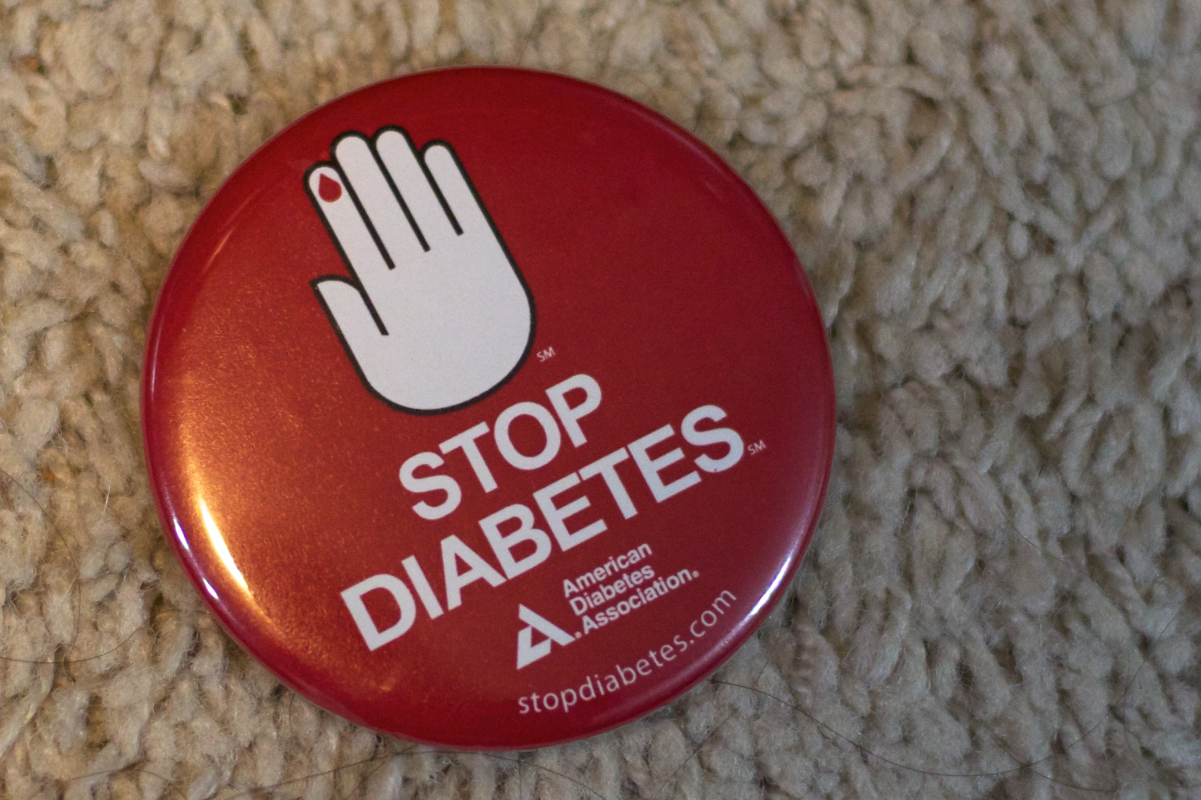
DIABETIC KETOACIDOSIS
(DKA)
By: JONAH GARGANTA

Slide 2

DIABETIC KETOACIDOSIS DEFINITION:
is a life-threatening problem that affects people with diabetes. It occurs when the body starts breaking down fat at a rate that is much too fast. The liver processes the fat into a fuel called ketones, which causes the blood to become acidic.
HYPERGLYCEMIA: BG>11MMOL/L
HYPERKETONEMIA OR HYPERKETONURIA
METABOLIC ACIDOSIS: PH<7.3 BICARBONATE <15MMOL

Slide 3


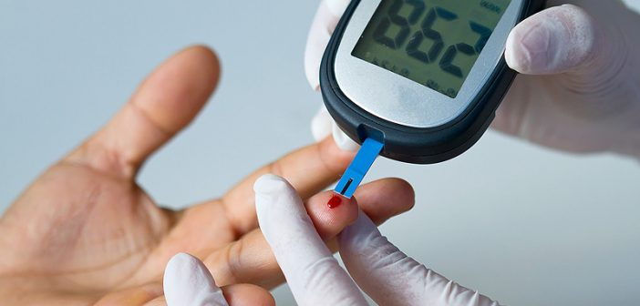

SIGNS AND SYPMPTOMS
Excessive thirst(POLYDIPSIA)
Frequent urination(POLYURIA)
Nausea and vomiting (dehydration)
Stomach pain
Weakness or fatigue
Shortness of breath
Acetone smell breath
Confusion
High blood sugar level
High ketone levels in your urine

Slide 4
RISKS FACTORS OR CAUSES
Pregnancy
Alcohol or drug abuse, particularly cocaine
Certain medications, such as corticosteroids and some diuretics
ILLNESS (PANCREATITIS/ STROKE)
PROBLEM WITH INSULIN
SURGERY OR PHYSICAL EMOTIONAL TRAUMA

Slide 5


Diagnosis
Blood sugar level.
Ketone level.
Blood acidity.
Blood electrolyte tests (ue, bone profile, cbc)
Urinalysis (osmolality)
Chest X-ray
ECG(electrocardiogram)

Slide 6
TREATMENT
Fluid replacement.
Electrolyte replacement.
Insulin therapy.

Slide 7

FLUID REPLACEMENT
5-10% dehydration = 10ml/kg of NS over an hour
In rare cases of shock or > 10% dehydration=20ml/kg isotonic bolus
Fluid management is given with maintenance plus deficit with isotonic fluid.
Total fluid per day should not exceed to 1.5 -2 maintenance
Fluid to adjust accordingly if BG fall rapidly to <15mmol to change IVF to 0.45 NACL+5% dextrose
Note: if serum osmolality >360 the deficit is given over 48 hours

Slide 8
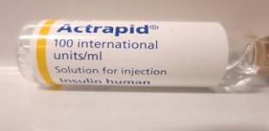
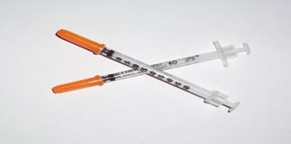
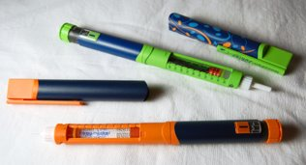
INSULIN THERAPY
-> regular insulin IV infusion to start 1 hour after fluid replacement
-> infusion rate: 0.05-0.1unit/kg/hr (50 units regulin insulin in 50 ml TV of NS, 1unit=1ml)
-> accept BG drop 8 mmol for 1st hour but no more 5-6 mmol there after
-> if BG drops fast change iv dextrose with D10% or d 15% depend on BG
-> If acidosis is corrected, insulin is reduce to 0.05iu/kg/hr
-> if acidosis corrected and BG within target, can start Subcutaneous (SC)insulin R 30 mins prior meals, then stop IV insulin 30 min. after SC insulin.

Slide 9
ELECTROLYTE CORRECTION
Potassium added to 500ml IVF( max of 20 mmol)
Potassium phosphate is added to IVF in case of severe hyposphatemia
Bicarbonate correction is NOT indicated in DKA, acidosis gets corrected with correction of dehydration / fluid therapy
Indication of Bicarbonate replacement:(1-2 mmol/kg over 2 hours)
PH<6.9 after initial resuscitation
Case of shock
Hyperkalemia and arrythmias

Slide 10


NURSING INTERVENTIONS.....
z

Slide 11
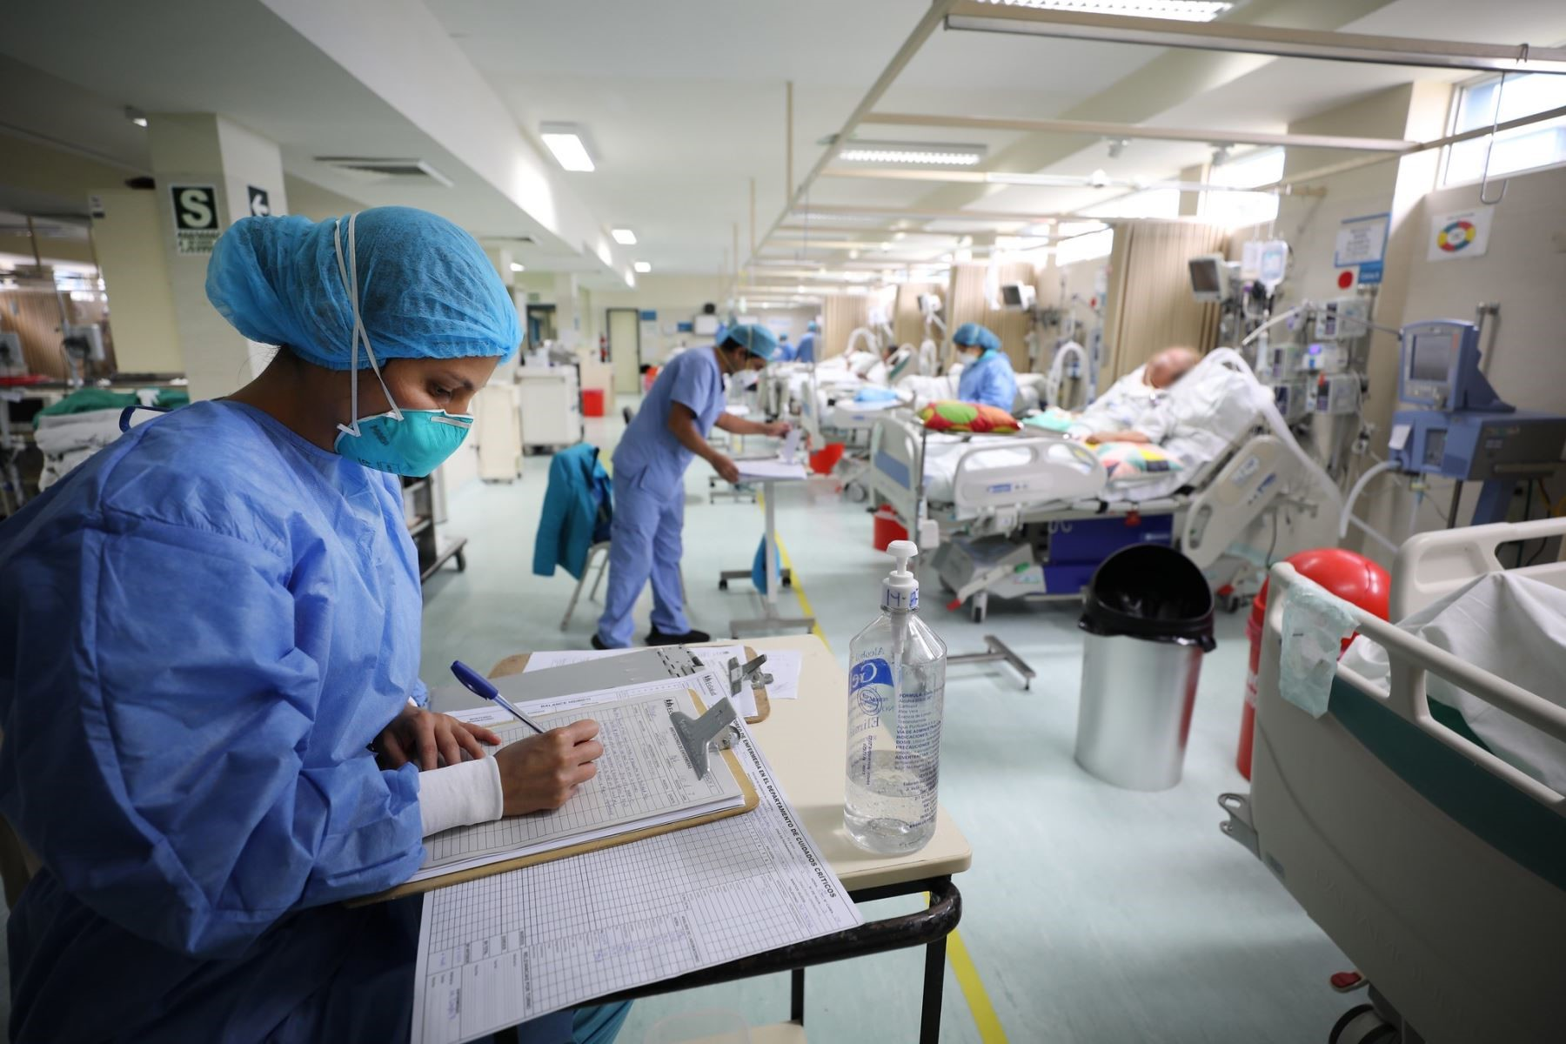
PRIORITY IS ASSESSMENT AND MONITORING !!!
GLASCOW COMA SCALE
BLOOD SUGAR
URINE KETONES
BLOOD KETONE
BLOOD ELECTROLYTES
KEEP NPO, 24 HOURS STRICT INTAKE OUTPUT
VITALS RESPIRATORY RATE , BP , HEART RATE, TEMPERATURE
SECURE IV LINES OR ARTERIAL LINE IF NEEDED
FLUID THERAPY
INSULIN THERAPY

Slide 12
AIM OF THERAPY:
CORRECT DEHYDRATION
CORRECT ACIDOSIS AND REVERSE KETOSIS
RESTORE GLUCOSE NEAR NORMAL (ANY TARGET GLUCOSE)
AVOID COMPLICATIONS OF TREATMENT
IDENTIFY AND TREAT PRECIPITATING EVENT

Slide 13


Slide 14
THANK YOU!!! HOPE YOU ENJOY =)
z

